Slide 1
Microwave and Satellite Communication
CSTE 3203

Slide 2
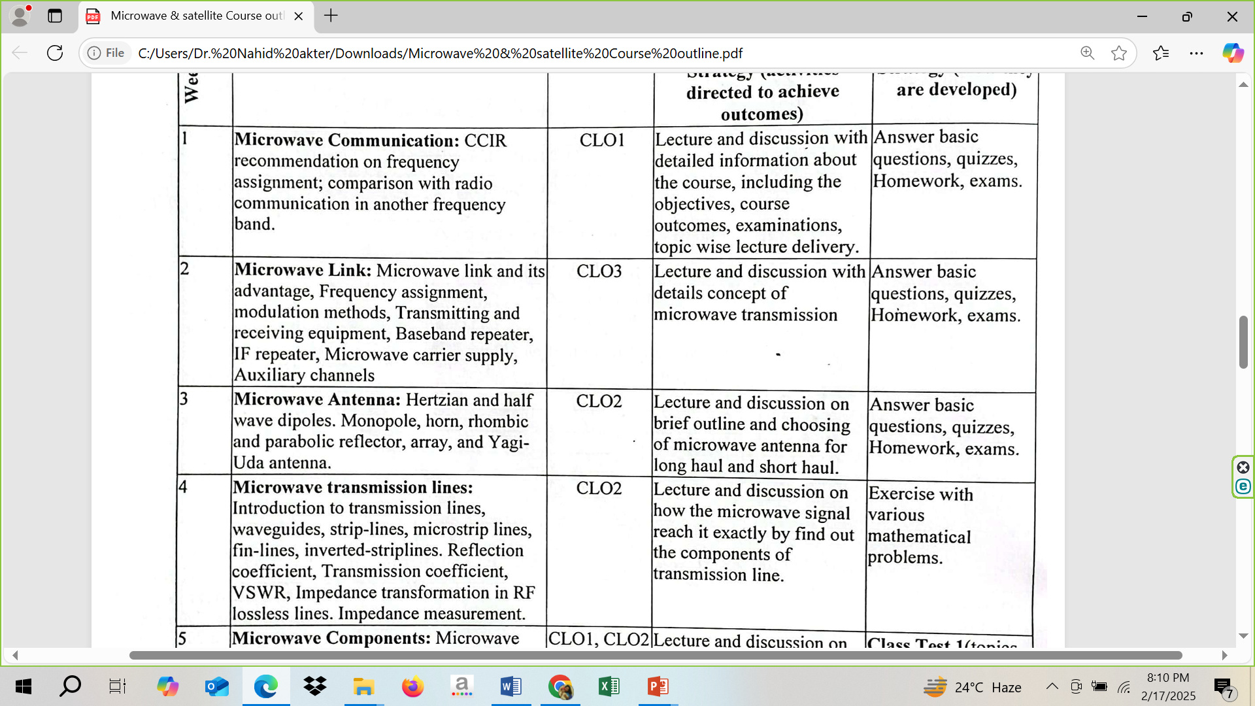

Slide 3
Antenna Fundamentals- 2

Slide 4
https://www.youtube.com/watch?v=ZaXm6wau-jc
How does an Antenna work? | ICT #4

Slide 5
Radiation Pattern
In the representation of radiation pattern, we often come across different shapes, which indicate the major and minor radiation areas, by which the radiation efficiency of the antenna is known.

Slide 6
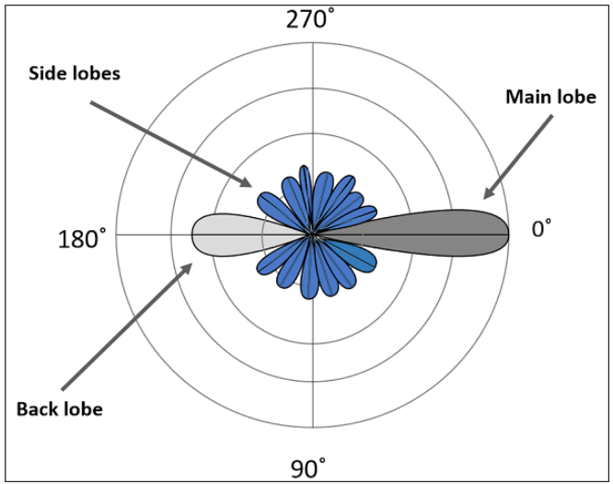
Lobe Formation

Slide 7
Lobe Formation
Here, the radiation pattern has main lobe, side lobes and back lobe.
The major part of the radiated field, which covers a larger area, is the main lobe or major lobe. This is the portion where maximum radiated energy exists. The direction of this lobe indicates the directivity of the antenna.

Slide 8
Lobe Formation
The other parts of the pattern where the radiation is distributed side wards are known as side lobes or minor lobes. These are the areas where the power is wasted.
There is other lobe, which is exactly opposite to the direction of main lobe. It is known as back lobe, which is also a minor lobe. A considerable amount of energy is wasted even here.

Slide 9
Lobe Formation
Example:
If the antennas used in radar systems produce side lobes, target tracing becomes very difficult. This is because, false targets are indicated by these side lobes. It is messy to trace out the real ones and to identify the fake ones. Hence, elimination of these side lobes is must, in order to improve the performance and save the energy.

Slide 10
Lobe Formation
Remedy:
The radiated energy, which is being wasted in such forms needs to be utilized. If these minor lobes are eliminated and this energy is diverted into one direction (that is towards the major lobe), then the directivity of the antenna gets increased which leads to antenna’s better performance.

Slide 11
Equivalent Isotropic Radiated Power
If the radiation is focused in certain angle, then EIRP increases along with the antenna gain. Gain of the antenna is best achieved by focusing the antenna in certain direction.
or
“The amount of power that an isotropic antenna radiates to produce the peak power density observed in the direction of maximum antenna gain, is called as Equivalent Isotropic Radiated Power.”

Slide 12
Effective Radiated Power
If the radiated power is calculated by taking half-wave dipole as the reference, rather than an isotropic antenna, then it can be termed as ERP (Effective Radiated Power).
ERP(dBW)=EIRP(dBW)−2.15dBi
[The gain of half wave dipole is 2.15dBi (theoretically), where, ‘i’ represents the isotropic radiation]

Slide 13
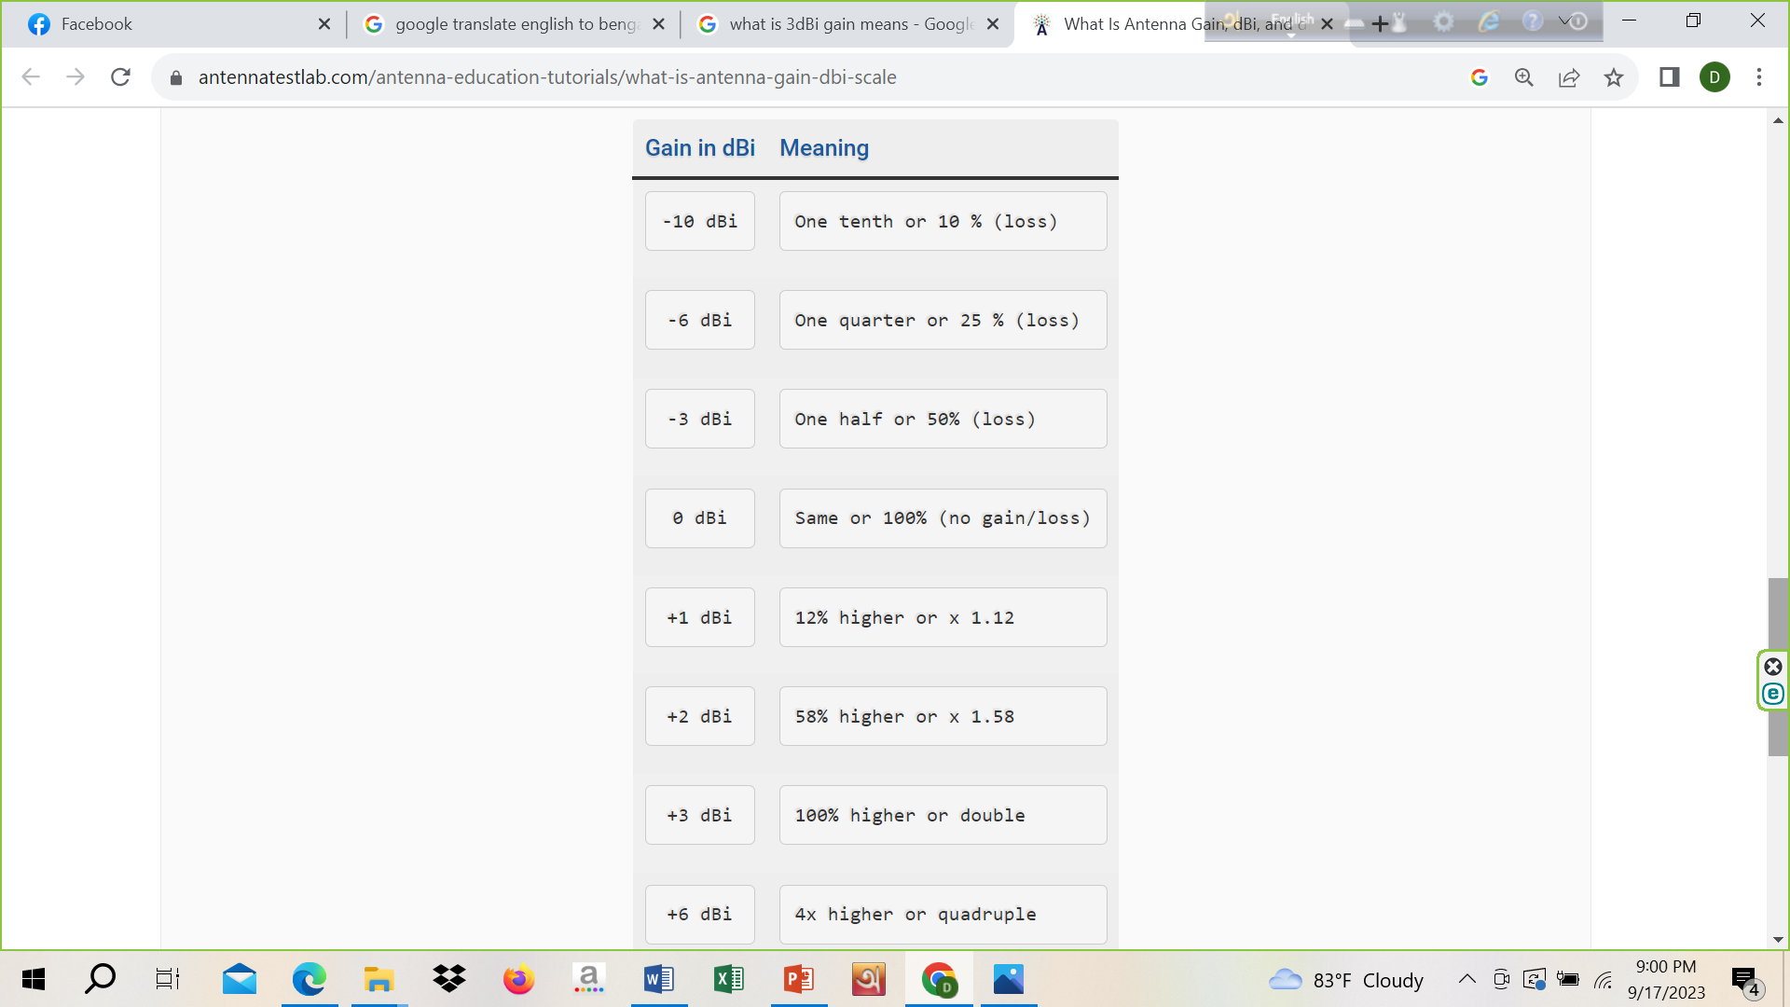
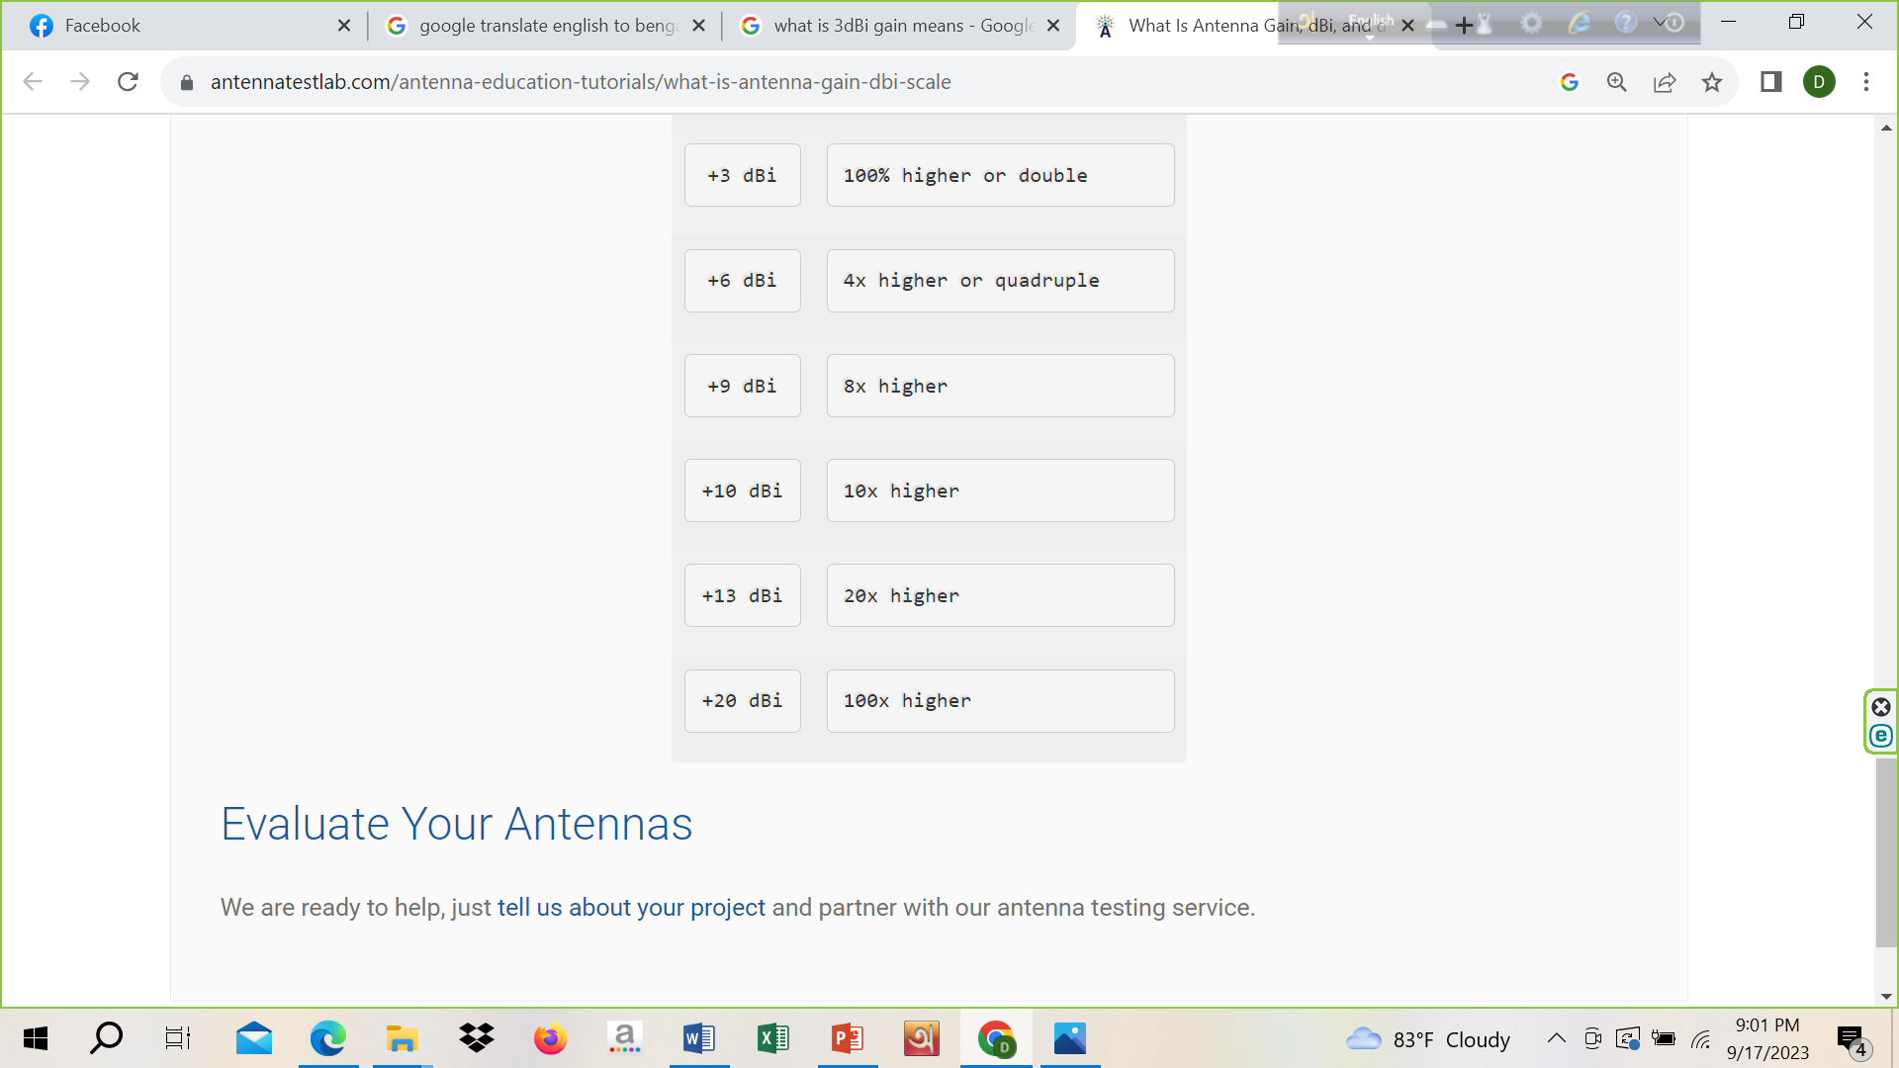

Slide 14
Beam

Slide 15
Beam Area
“Beam area is the solid angle through which all the power radiated by the antenna would stream if P (θ, Ø) maintained its maximum value over beam area or beam angle (Ω_{A}) and was zero elsewhere.”
The radiated beam of the antenna comes out from an angle at the antenna, known as solid angle, where the power radiation intensity is maximum. This solid beam angle is termed as the beam area. It is represented by Ω_{A}.
The radiation intensity P (θ, Ø) should be maintained constant and maximum throughout the solid beam angle Ω_{A}, its value being zero elsewhere.

Slide 16
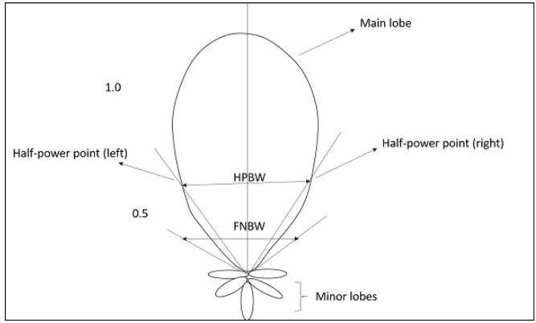
Beam Area
Beam angle is a set of angles between the half power points of the main lobe.

Slide 17
Beam Area
The mathematical expression:
Ω_{A}=∫₀^{2π} ∫₀^{π}P_{π}(θ,Φ)dΩ watts
dΩ=sinθ dθ dΦ watts
Where
Ω_{A} is the solid beam angle.
θ is the function of angular position.
Φ is the function of radial distance.
The unit of beam area is watts.

Slide 18
Beam Efficiency
“The beam efficiency states the ratio of the beam area of the main beam to the total beam area radiated.”
Mathematical Expression:
η_{B}=Ω_{MB /}Ω_{A}
Where,
η_{B} is the beam efficiency.
Ω_{MB} is beam area of the main beam.
Ω_{A} is total solid beam angle (beam area).

Slide 19
Beam Width
Beam width is the aperture angle from where most of the power is radiated. The two main considerations of this beam width are Half Power Beam Width (HPBW) and First Null Beam Width (FNBW).
“The angular separation, in which the magnitude of the radiation pattern decreases by 50% (or -3dB) from the peak of the main beam, is the Half Power Beam Width.”
In other words, Beam width is the area where most of the power is radiated, which is the peak power. Half power beam width is the angle in which relative power is more than 50% of the peak power, in the effective radiated field of the antenna.

Slide 20
HPBW
When a line is drawn between radiation pattern’s origin and the half power points on the major lobe, on both the sides, the angle between those two vectors is termed as HPBW, half power beam width.

Slide 21
HPBW
Mathematical Expression
Half power Beamwidth=70λ/D
Where
λ is wavelength
D is Diameter
The unit of HPBW is radians or degrees.

Slide 22
First Null Beam Width
“The angular span between the first pattern nulls adjacent to the main lobe, is called as the First Null Beam Width.”
Simply, FNBW is the angular separation, away from the main beam, which is drawn between the null points of radiation pattern, on its major lobe.
Indication of FNBW:
Draw tangents on both sides starting from the origin of the radiation pattern, tangential to the main beam. The angle between those two tangents is known as First Null Beam Width (FNBW).

Slide 23
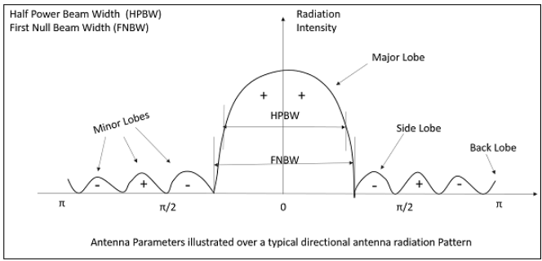
FNBW

Slide 24
FNBW
Mathematical Expression
FNBW=2HPBW
FNBW=2(70λ/D)=140λ/D
Where
λ is wavelength
D is Diameter
The unit of FNBW is radians or degrees.

Slide 25
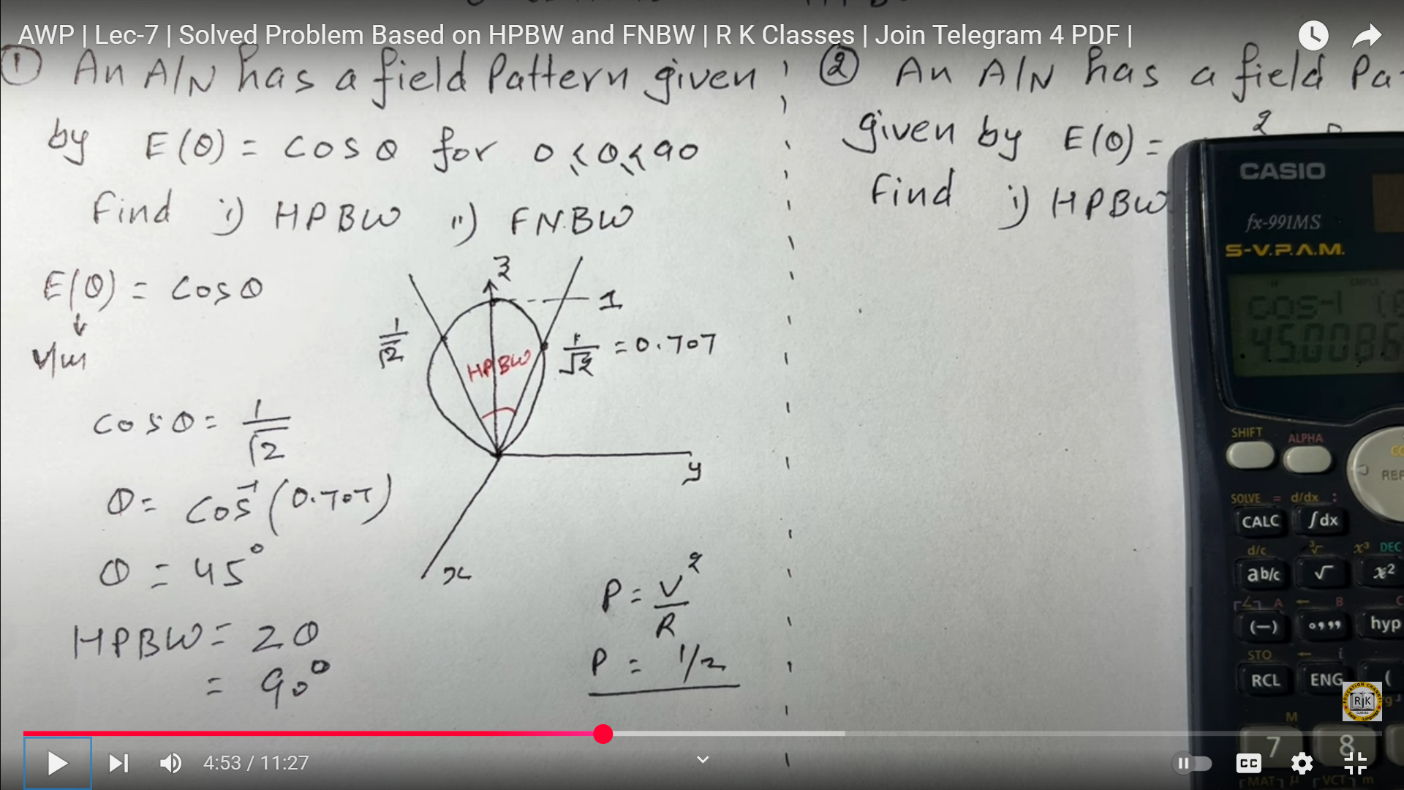
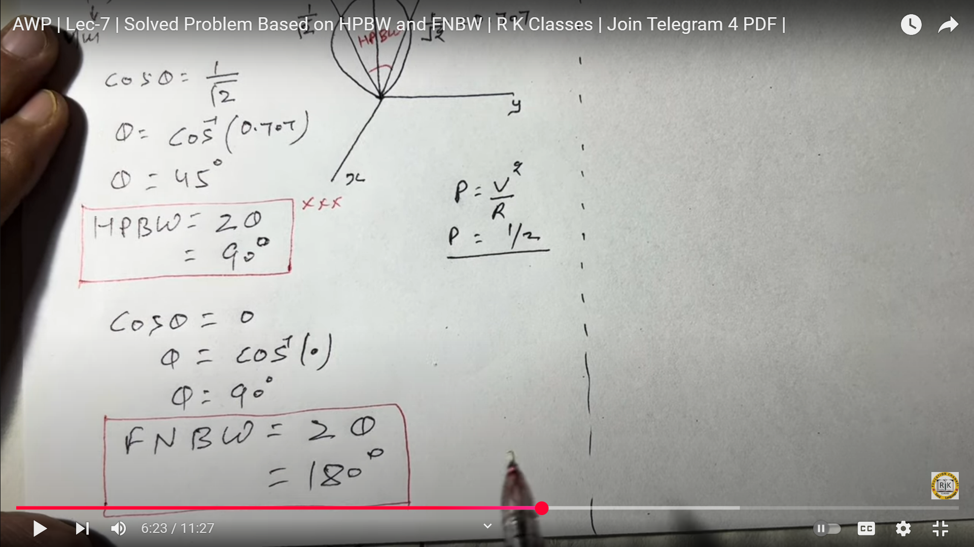
Problem-Solution

Slide 26
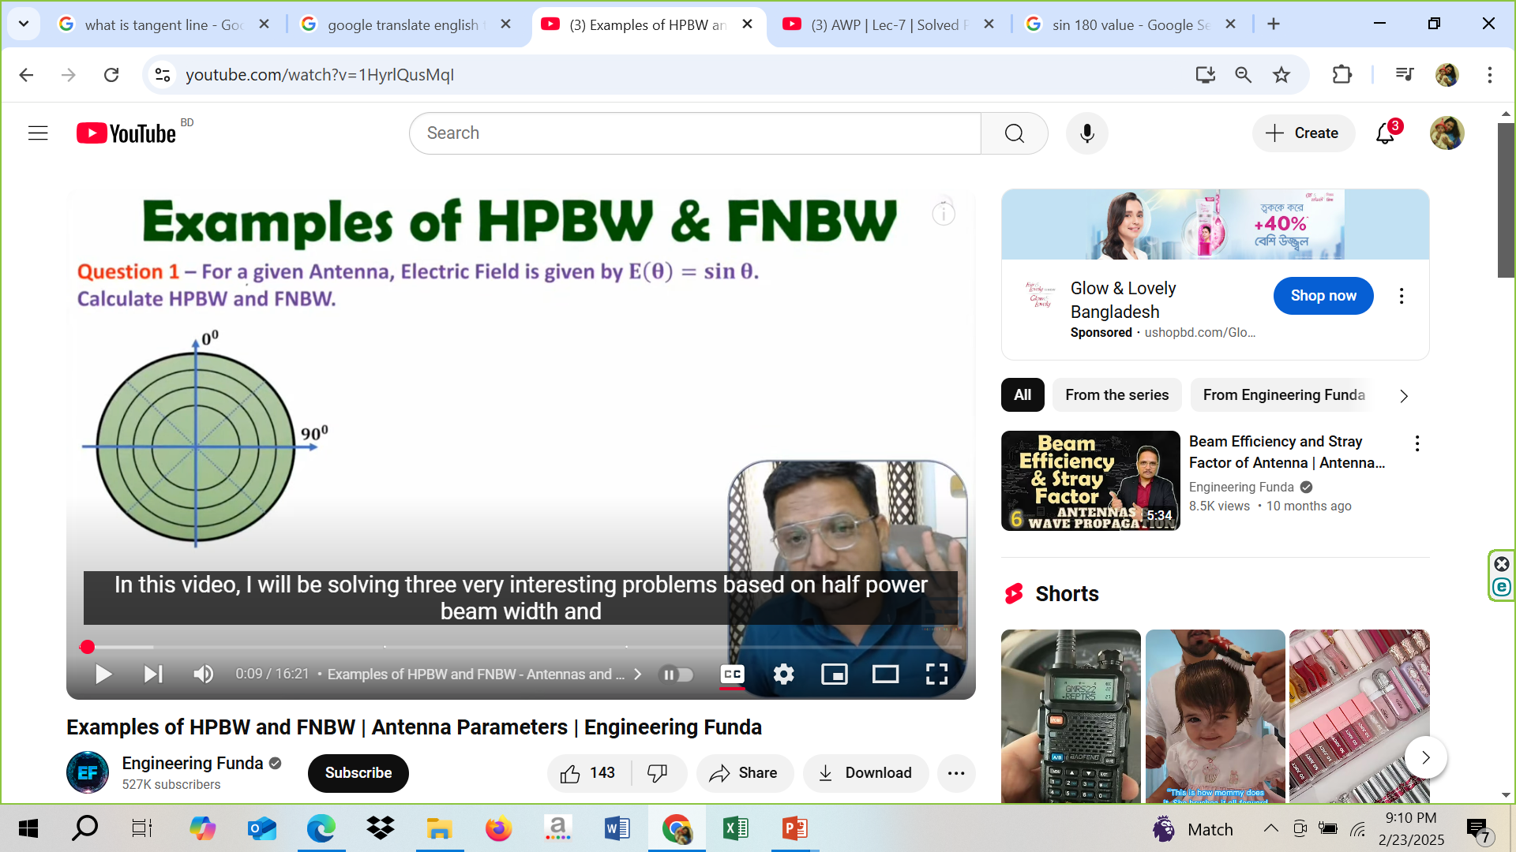

Homework
θ=14.32

Slide 27
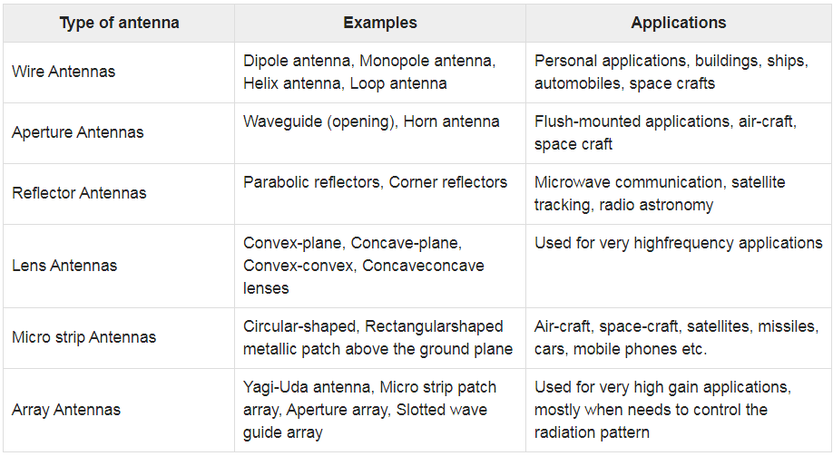

Slide 28
Hertzian Dipole Antenna

Slide 29
Hertzian Antenna/ Dipole Antenna
A dipole antenna, developed by Heinrich Rudolph Hertz around 1886 is an antenna that can be made by a simple wire, with a center-fed driven element for transmitting or receiving radio frequency energy. These antennas are the simplest practical antennas from a theoretical point of view; the current amplitude on such an antenna decreases uniformly from maximum at the center to zero at the ends.
It is considered as the first experimental proof of Maxwell’s equations.

Slide 30
Hertzian Dipole Antenna
The Hertzian dipole is a theoretical dipole antenna that consists of an infinitesimally small current source acting in free-space. Although a true Hertzian dipole cannot physically exist, very short dipole antennas can make for a reasonable approximation.
The length of this antenna is significantly smaller than the wavelength, theoretically
ℓ_{ז}=λ/50
The radiation resistance is given by: R_{ז}=2π/3 Z₀ (ℓ/ λ)²
Where Z₀ is the impedance of free space.

Slide 31
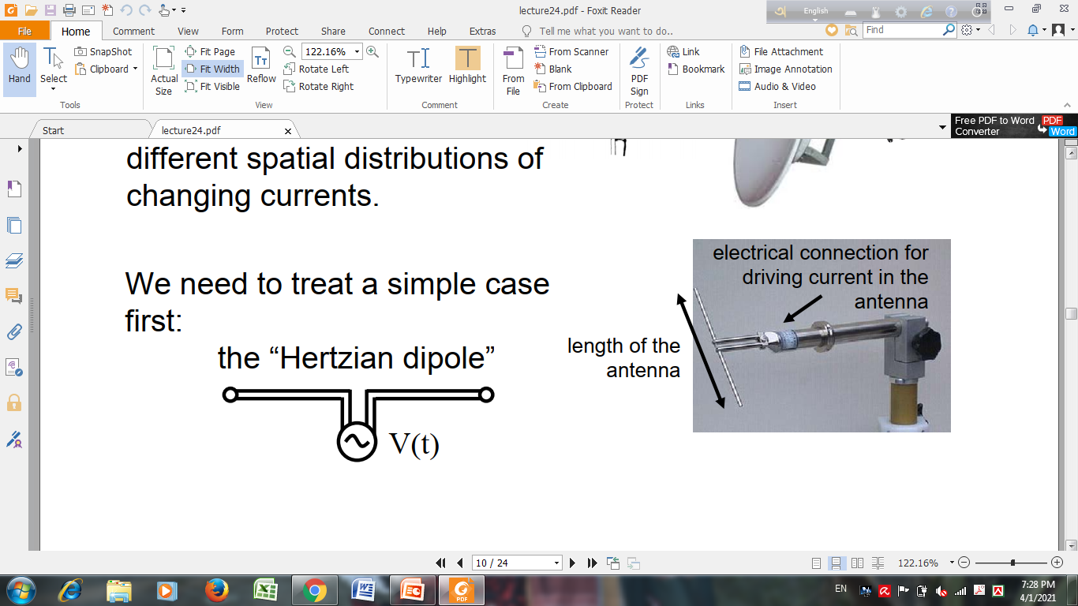
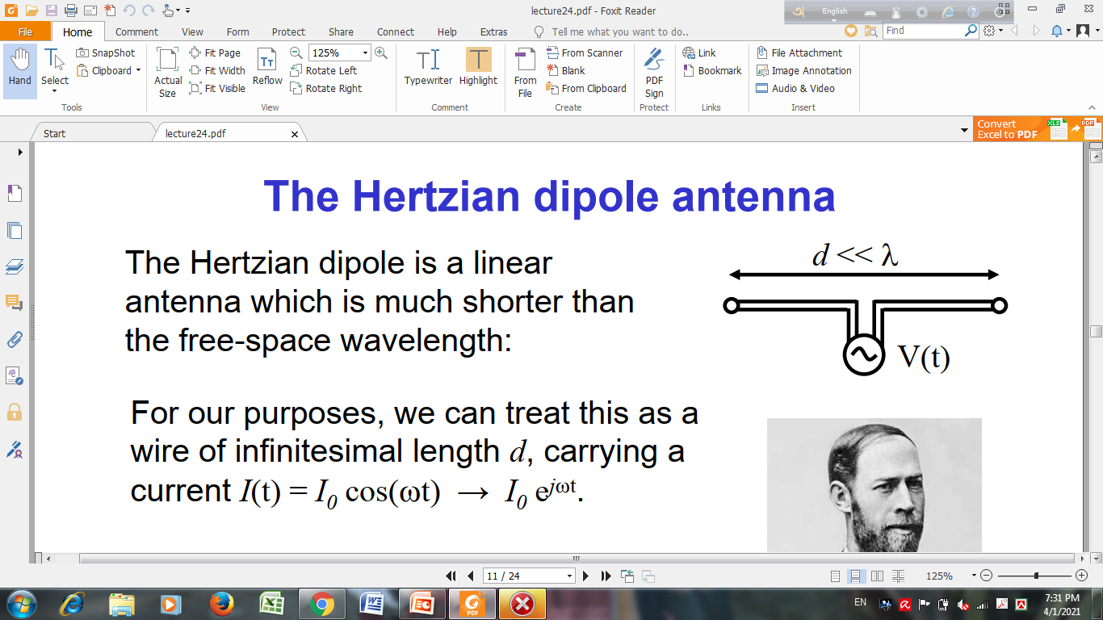
Hertzian Dipole Antenna

Slide 32
Hertzian Dipole Antenna
The Hertzian dipole is a linear antenna which is much shorter than the free-space wavelength.
We can treat this as a wire of infinitesimal length d, carrying a current
I (t) = I₀ cos(ωt) → I₀ e^{j ωt}

Slide 33
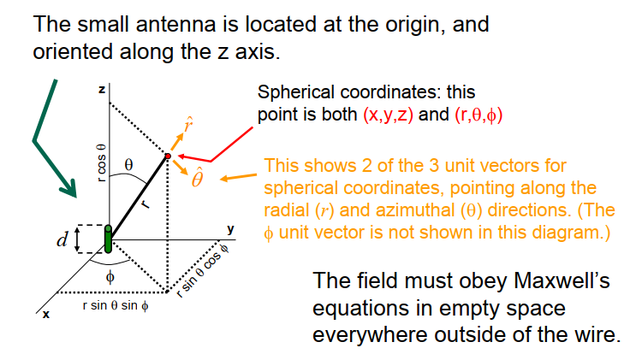
Coordinate System (Recap)

Slide 34
Field Pattern

Slide 35
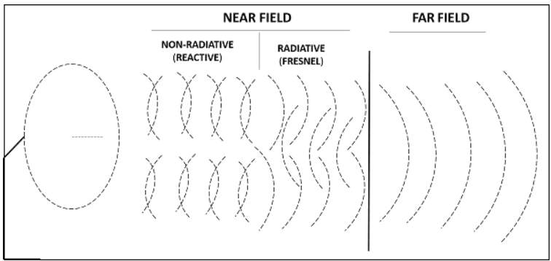
Recap (Field Pattern)

Slide 36
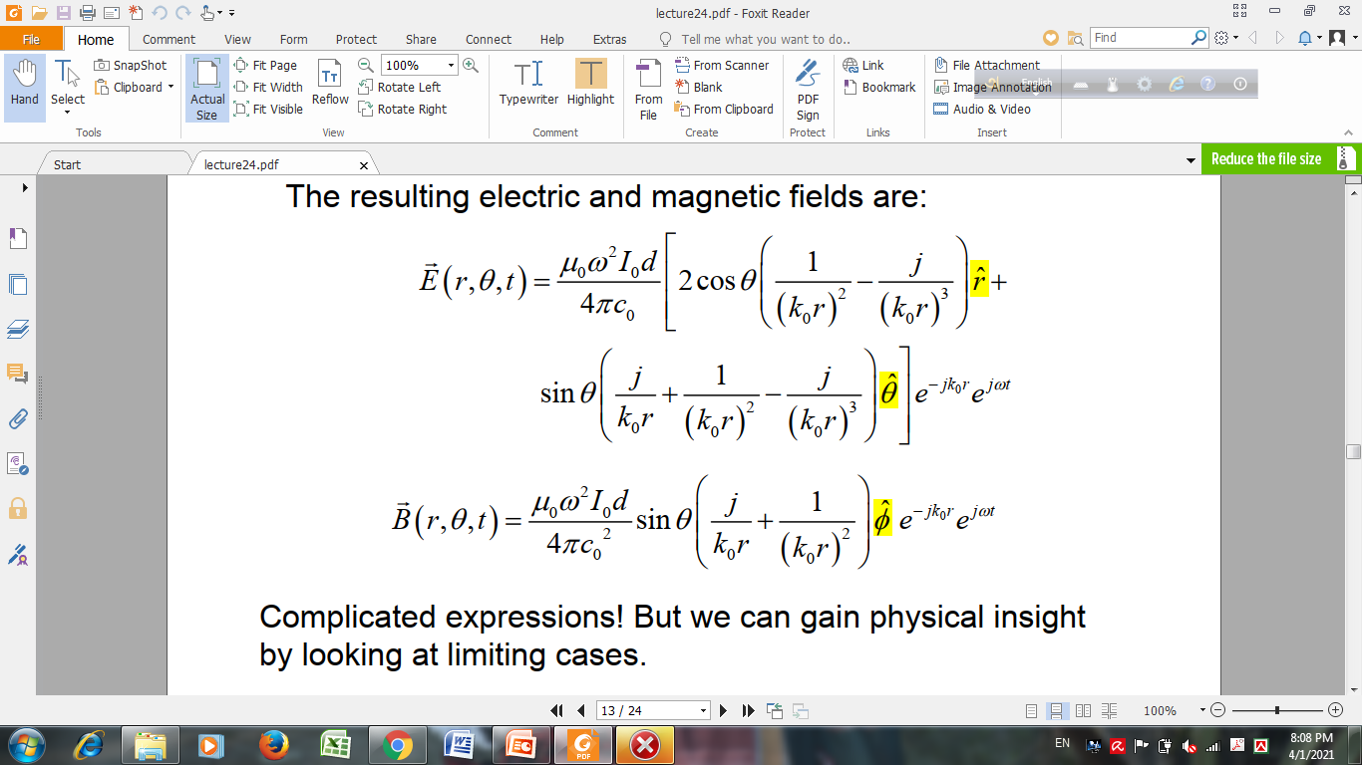
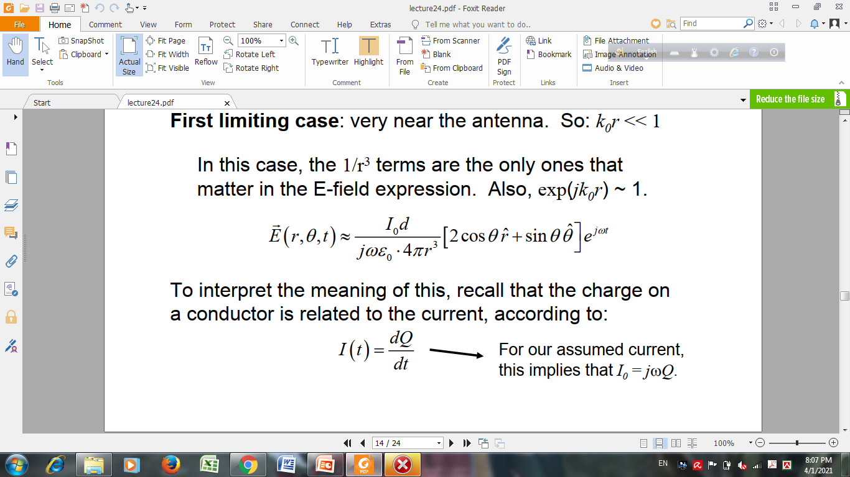
Field of Hertzian Dipole (Near Field Approach)
Resulting Electric Field
Very near the antenna
k₀r<<1
e^{-jk}₀^{r}∼1
1/r³ terms present
in the E field

Slide 37
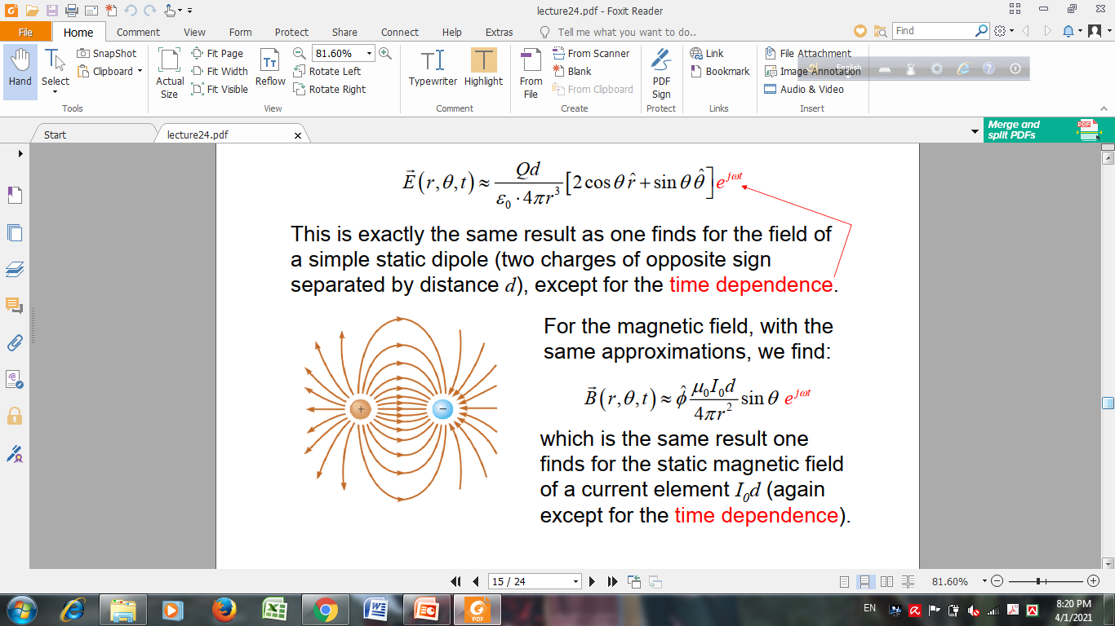
Field of Hertzian Dipole (Near Field Approach)

Slide 38
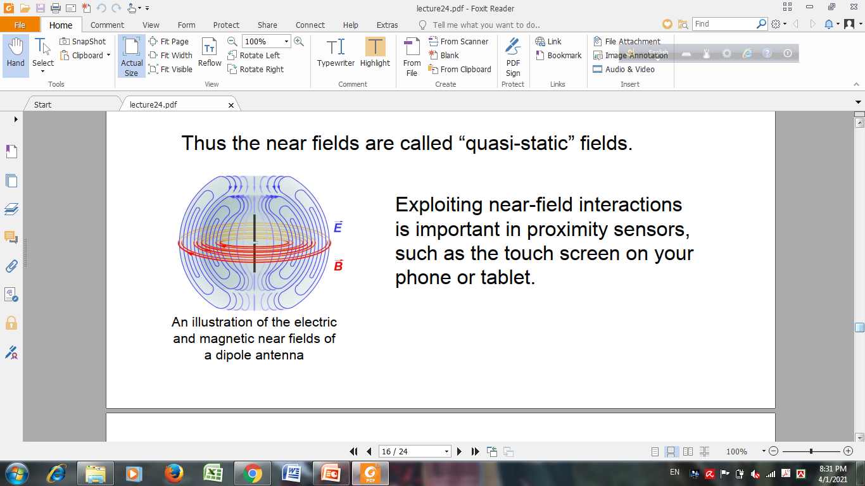
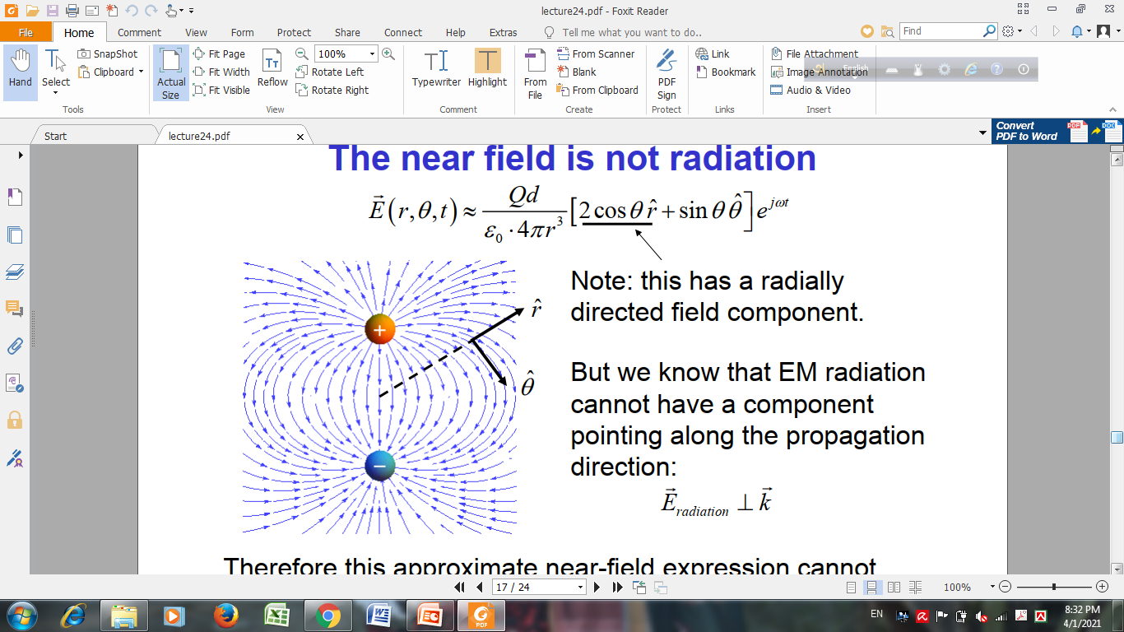
Near Field: Quasi-Static Fields

Slide 39
Near Field is not Radiation

Slide 40
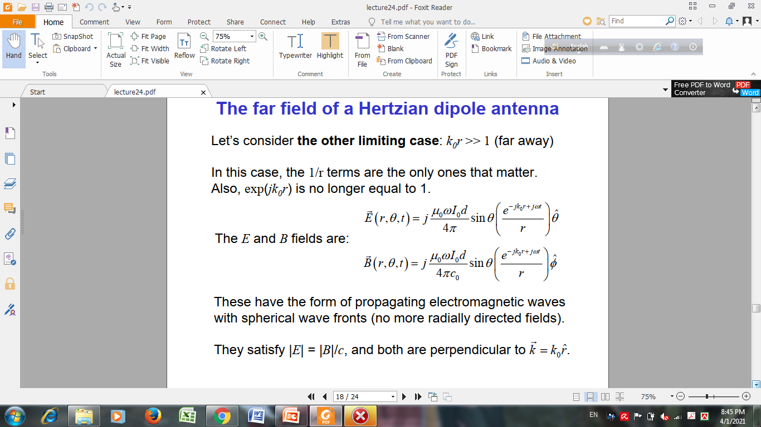
Field of Hertzian Dipole (Far Field Approach)
k₀r>>1
e^{-jk}₀^{r}≆1
1/r terms present
in the field
These have the form of propagating electromagnetic waves with spherical wave fronts (no more radially directed fields). They satisfy |E| = |B|/c, and both are perpendicular.

Slide 41
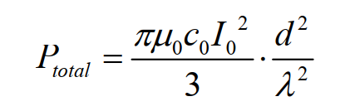
Power Radiated by Hertzian Dipole
The total radiated power is proportional to the square of the current in the antenna, and the square of its length

Slide 42
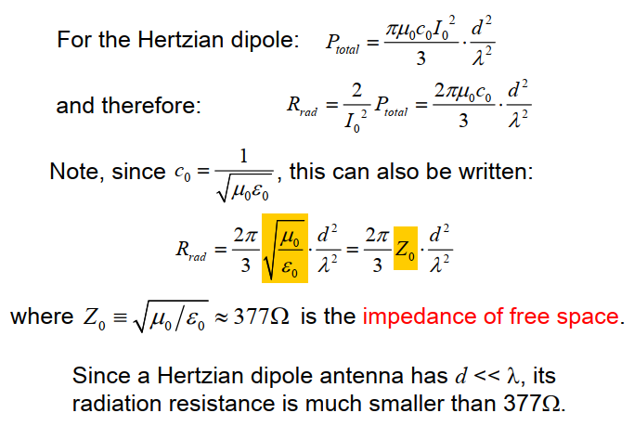
Radiation Resistance

Slide 43
Radiation Resistance (Home Work)
If a Hertzian dipole length d= 0.1λ
Calculate R_{rad}??

Slide 44
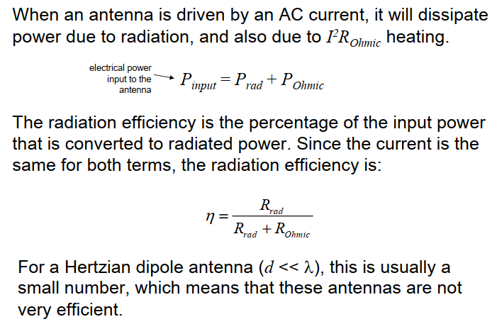
Radiation Efficiency

Slide 45
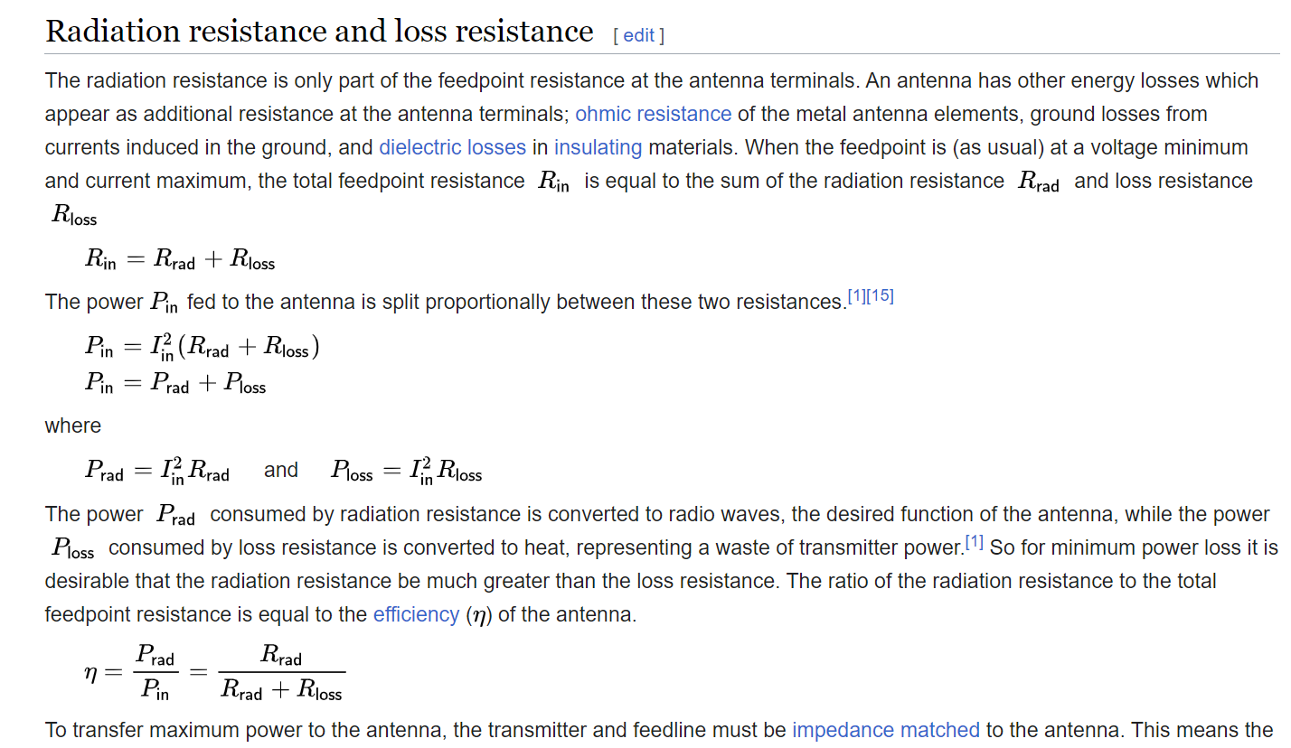

Slide 46
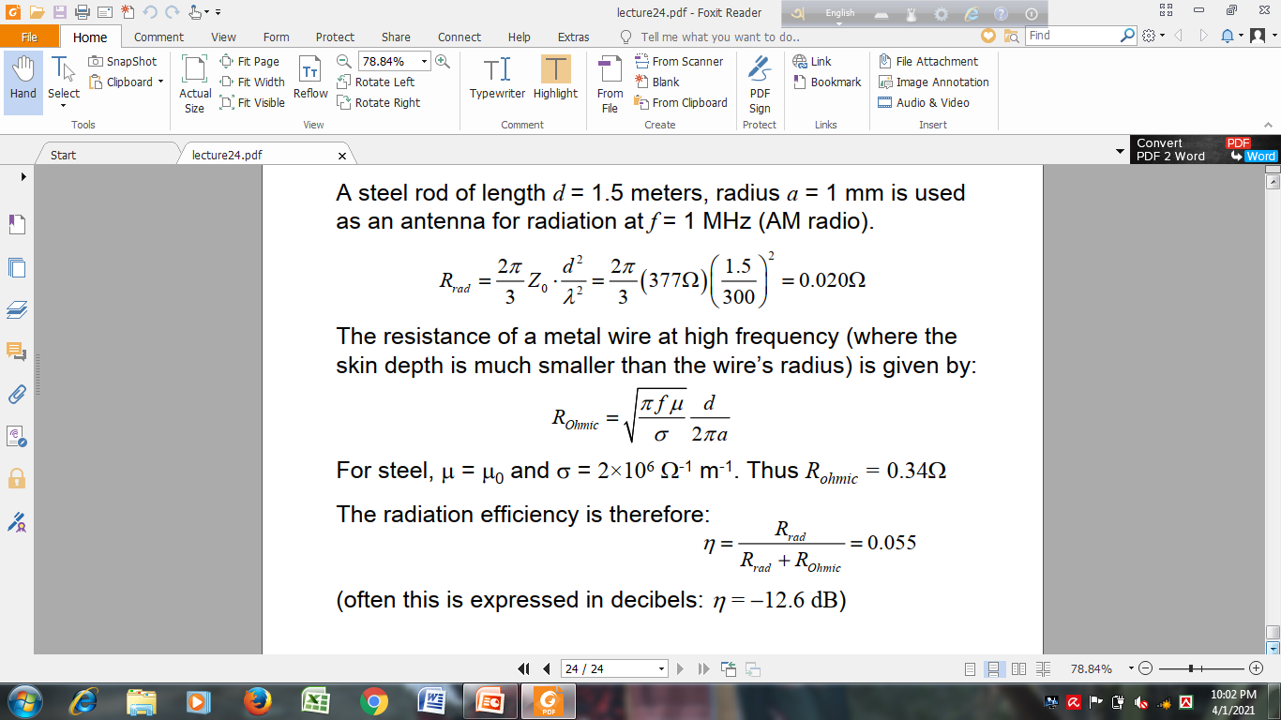
Example (Home Work)

Slide 47
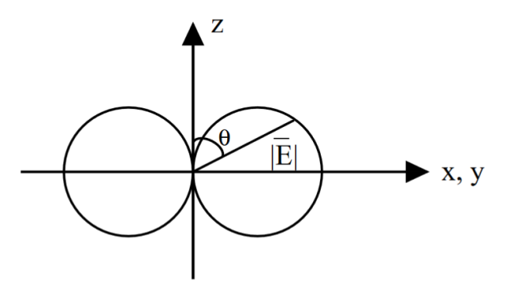
Radiation Pattern

Slide 48
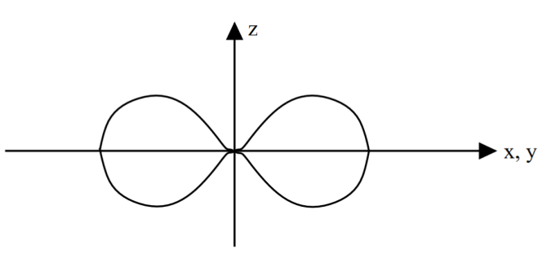
Power Pattern

Slide 49
Radiation Pattern, Gain, Effective Aperture
Dipoles have a radiation pattern, shaped like a toroid (doughnut) symmetrical about the axis of the dipole. The radiation is maximum at right angles to the dipole, dropping off to zero on the antenna's axis.
The theoretical maximum gain of a Hertzian dipole is constant 1.5 which corresponds to 10 log₁₀ 1.5= 1.76 dBi. For half wave dipole antenna the maximum theoretical gain is 1.64 which corresponds to 10 log₁₀ 1.64 or 2.15 dBi.
The maximum effective aperture is: A_{e}=3 λ²/8π
A surprising result is its effective aperture which is comparable to antennas many times its size.

Slide 50
Hertzian Dipole Antenna
The radiation resistance is typically a fraction of an ohm, making the infinitesimal dipole an inefficient radiator. The directivity D, which is the theoretical gain of the antenna assuming no ohmic losses (not real-world), is a constant of 1.5, which corresponds to 1.76 dB. Actual gain will be much less due to the ohmic losses and the loss inherent in connecting a transmission line to the antenna, which is very hard to do efficiently considering the incredibly low radiation resistance. The maximum effective aperture is: A_{e}=3 λ²/8π

Slide 51
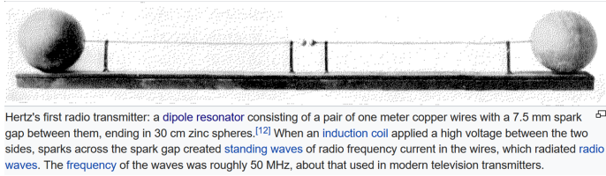
Hertz Original Experiment on Small Dipole

Slide 52
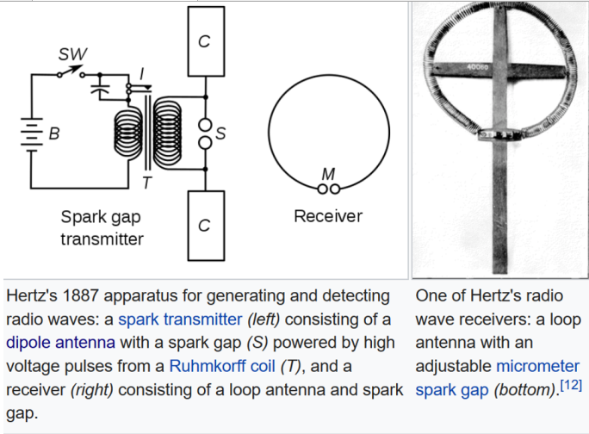

Slide 53
Background
A metallic sphere has a capacitance in closed form with respect to infinity or a ground plane. Hertz could use those knowledge to estimate the capacitance of the sphere, and also, he could estimate the inductance of the leads that are attached to the dipole, and hence, the resonance frequency (ω=1/√(LC))of this antenna. The large sphere is needed to have a large capacitance, so that current can be driven through the wires. Again we shall see, the radiation strength of the dipole is proportional to p = ql the dipole moment. To get a large dipole moment, the current flowing in the lead should be large.

